Slide 1
Media Sentiment and the Stock Market

Slide 2
Hello!
Christian Attard
Jess Alcalde
Nitin Khade
Rachel Torres

Slide 3
What is the impact of news on the stock market?
Good, bad, or neutral we will explore the effects of news on the S&P 500 and Nasdaq indexes

Slide 4
MARKET INDEXES
S&P 500
The S&P 500, or just the S&P, is an American stock market index based on the market capitalizations of 500 large companies having common stock listed on the NYSE, NASDAQ, or the Cboe BZX Exchange.
Nasdaq
The NASDAQ Composite is a stock market index of the common stocks and similar securities listed on the NASDAQ stock market. The composition of the NASDAQ Composite is heavily weighted towards information technology companies.

Slide 5

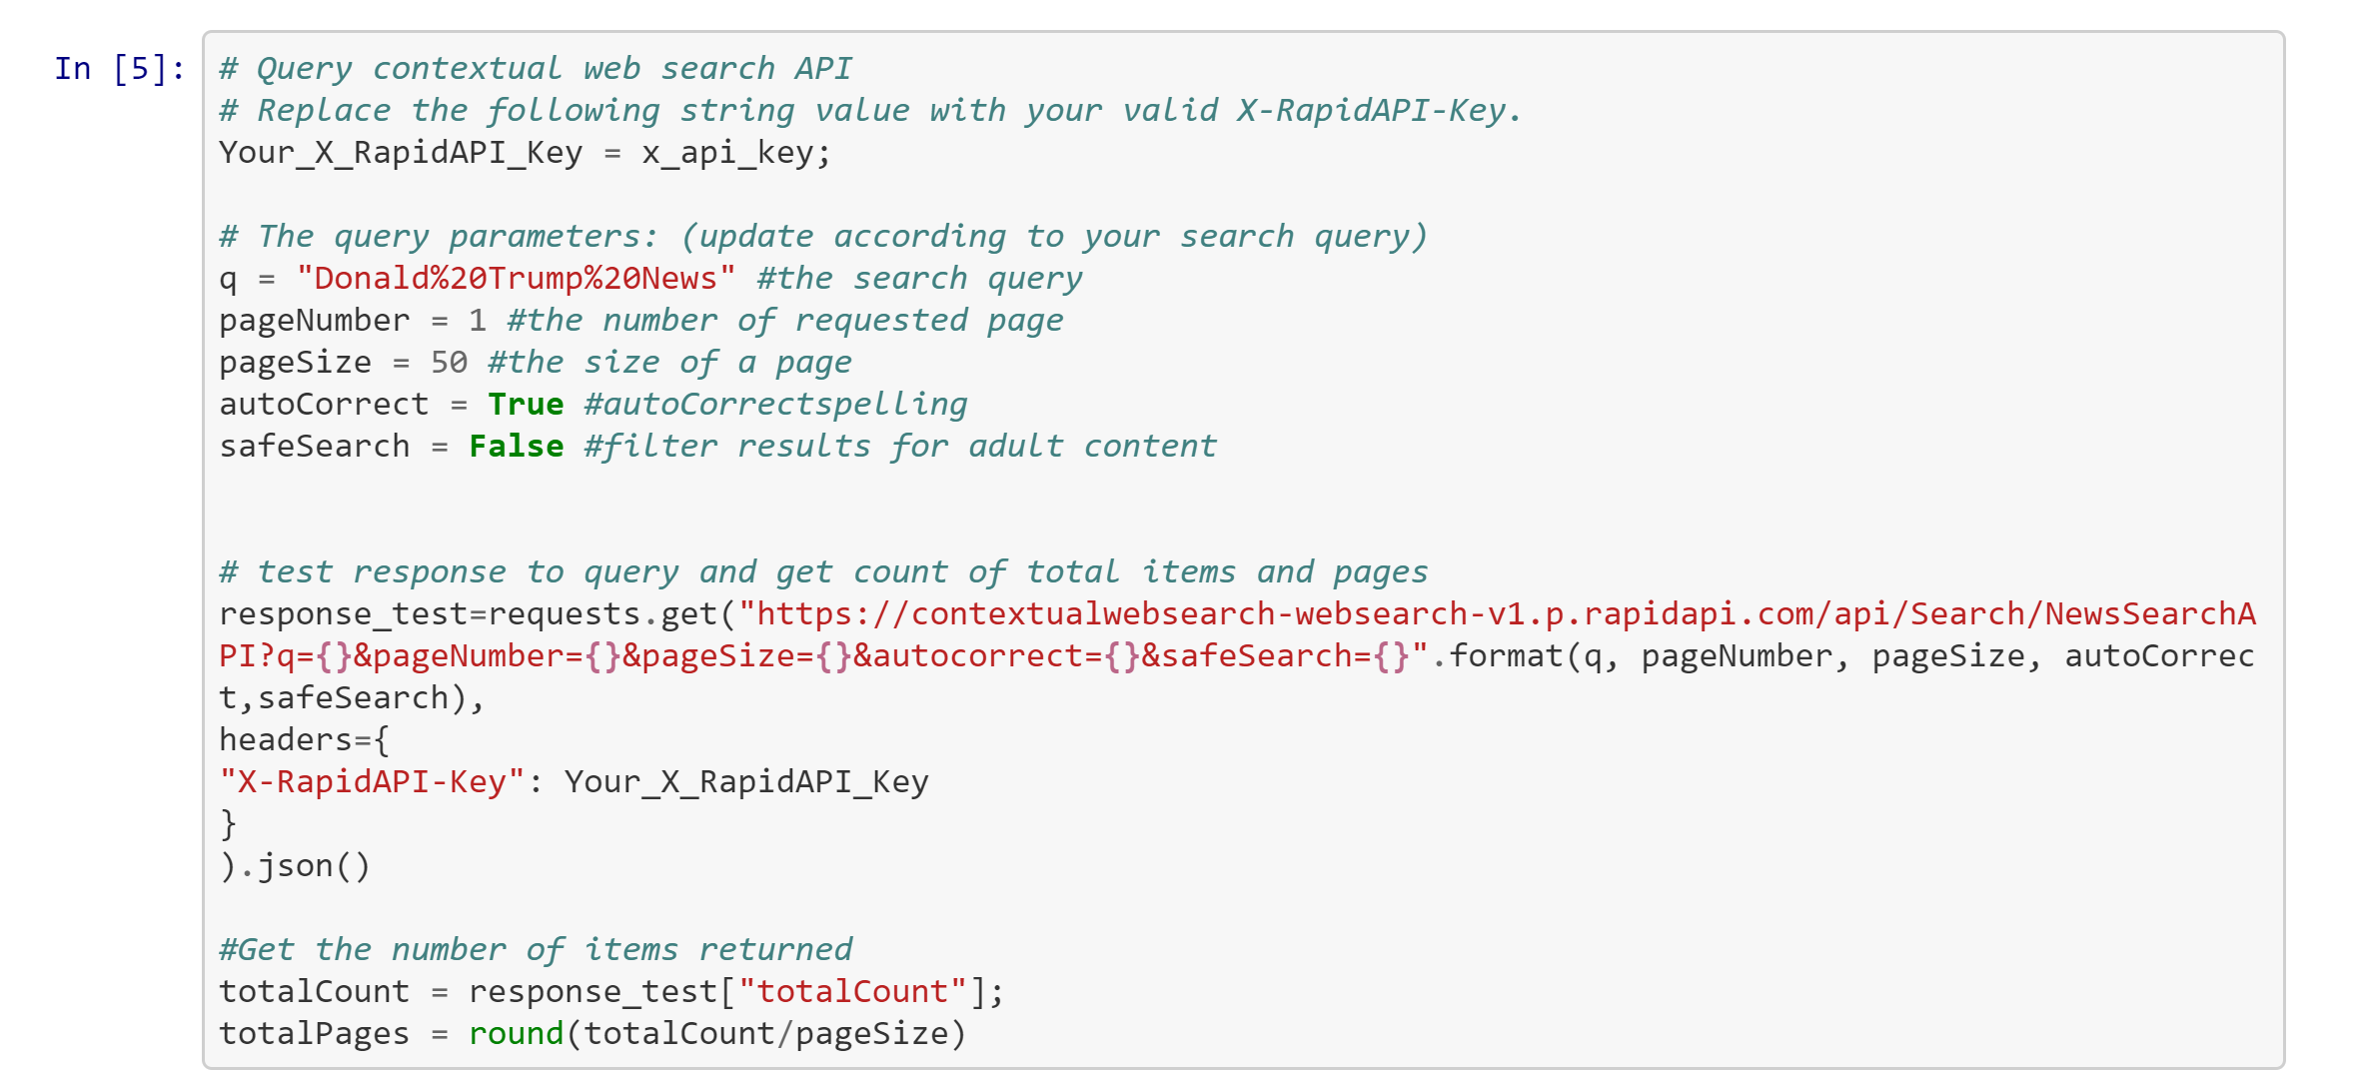
Methodology
We went through several iterations of news data sources, but eventually settled on the Contextual Web NewsSearch API.
The API takes in a query "q" and returns an article headline, description, publishing date, keywords, URL and news provider.

Slide 6
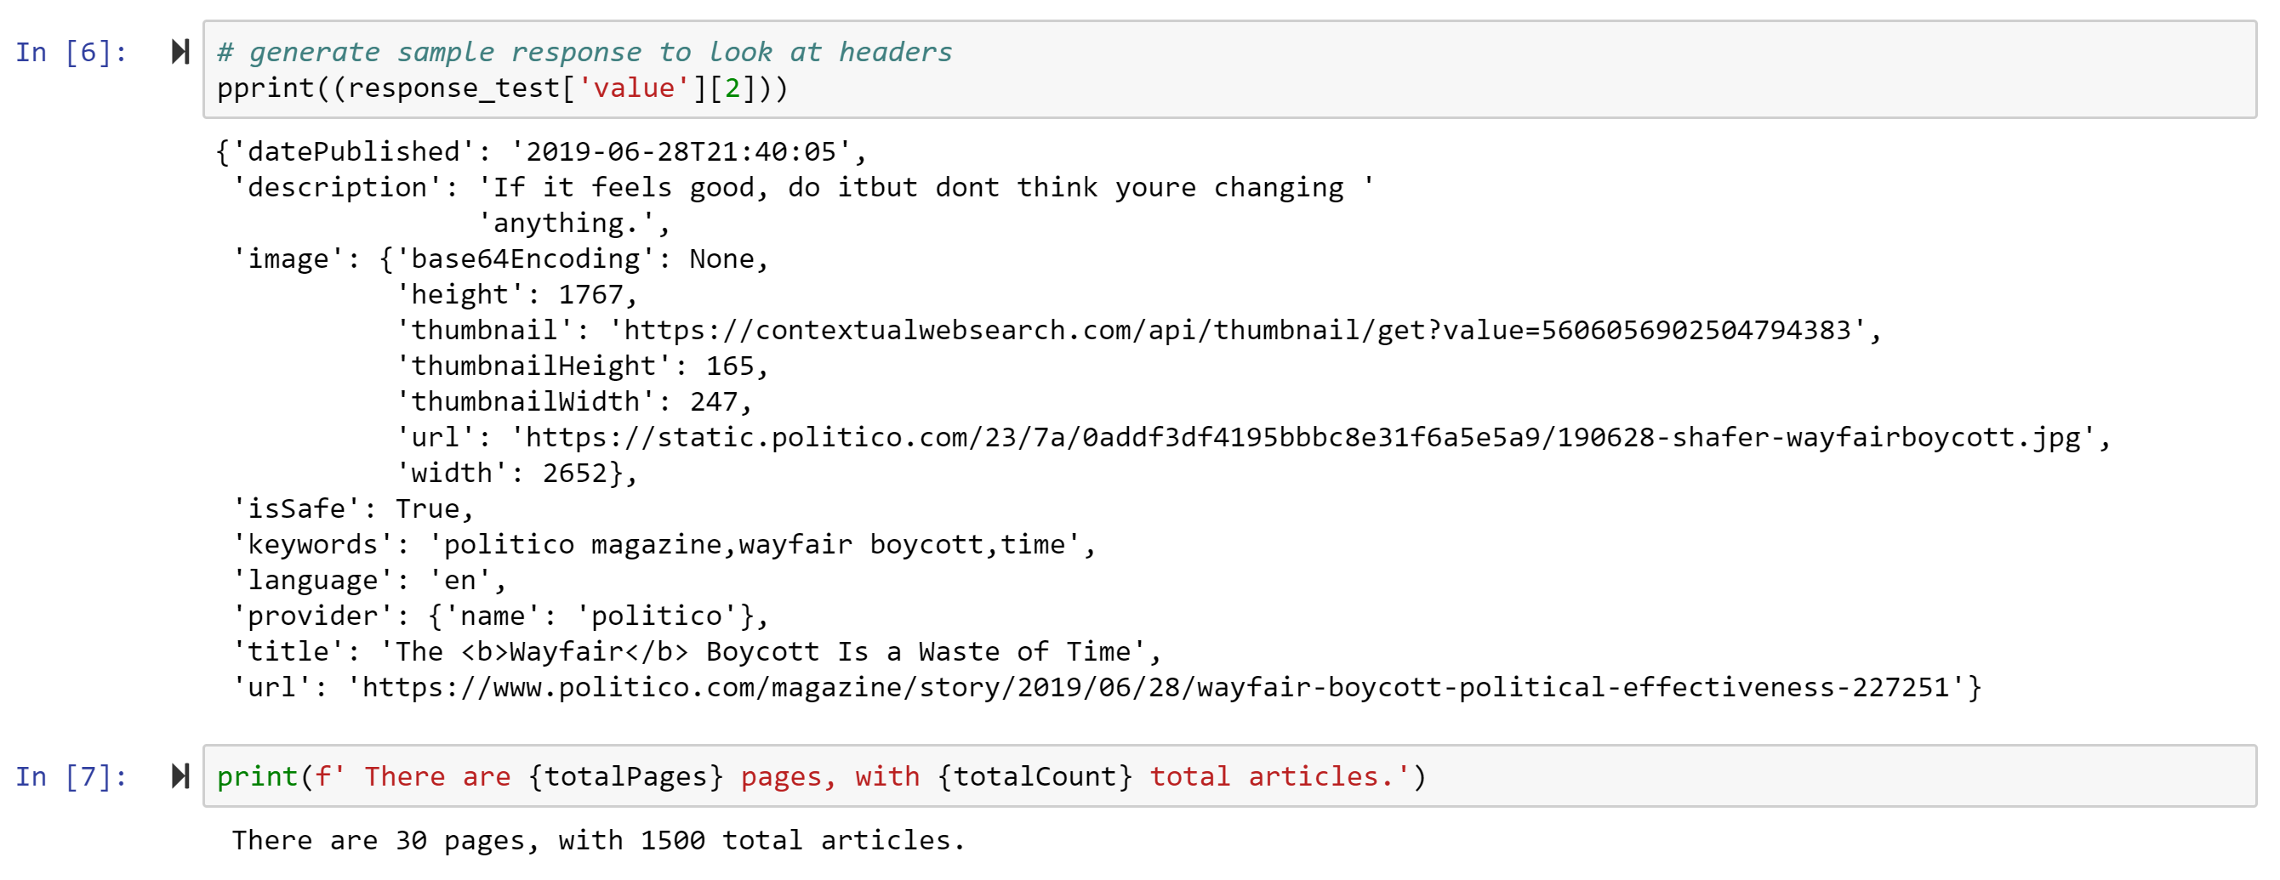
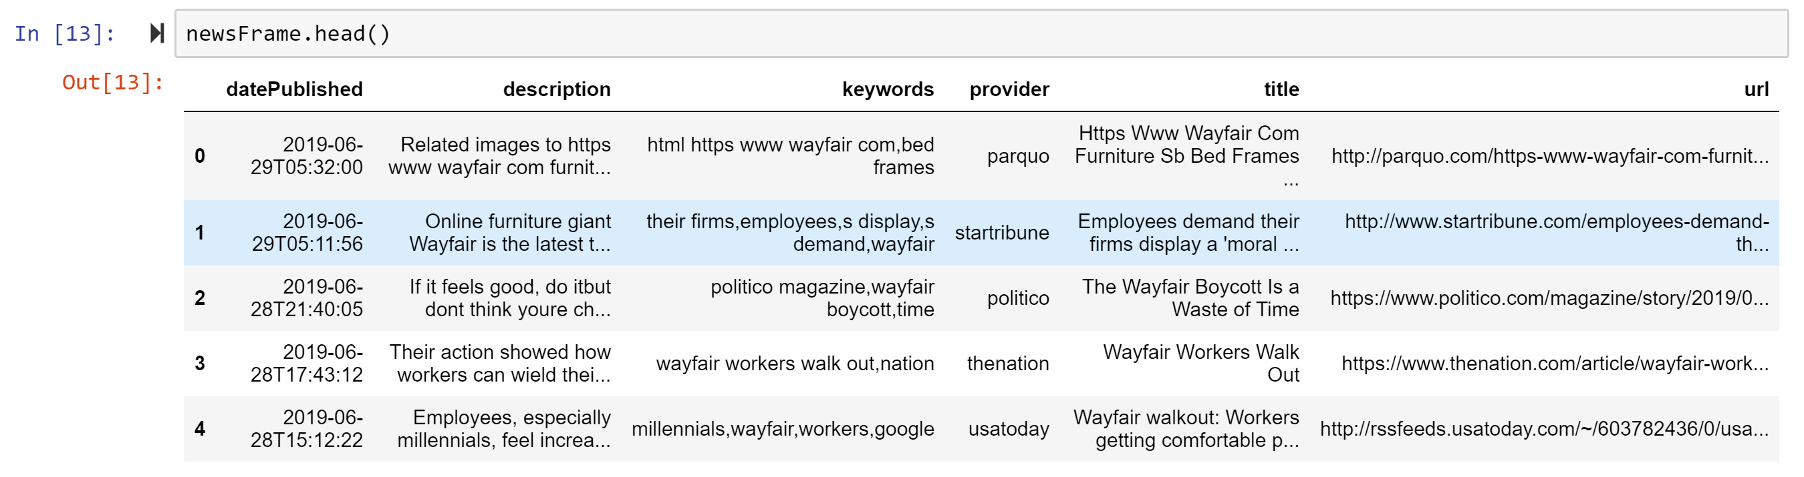
Sample of JSON Result
Our Initial DataFrame

Slide 7
SENTIMENT ANALYSIS
To do the sentiment analysis of the news data, we used vaderSentiment, a Python library built to do sentiment analysis of social media texts, but also widely applicable to all ranges of textual data.
Normalized weighted composite score
Positive sentiment: compound score >= 0.05
Neutral sentiment: (compound score >= 0.05) and compound score < 0.05)
Negative sentiment: compound score <= -0.05
Ratios for proportions of text that fall in each category
Notes:
Uses punctuation, bolds, repetition of statements, degree modifiers, conjunction and other textual features to qualify a text as “Positive”, “Neutral", or “Negative”

Slide 8
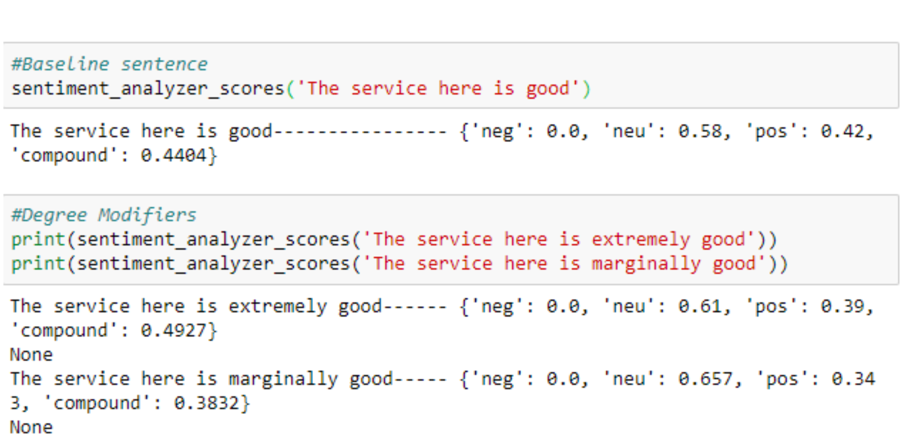
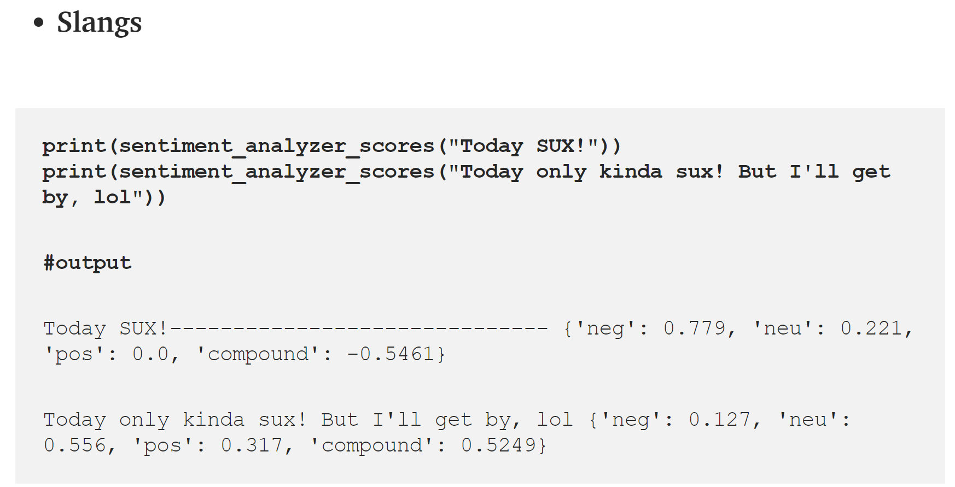
Examples of how VaderSentiment Treats Varying Texts

Slide 9
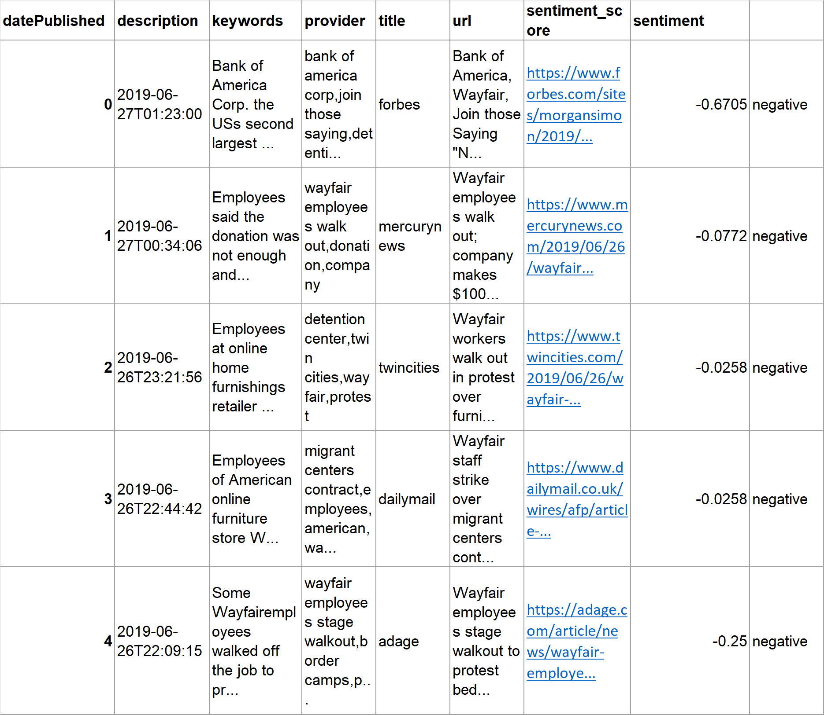
We pulled the combined compound sentiment score into the dataframe using the headline description as our argument.

Slide 10
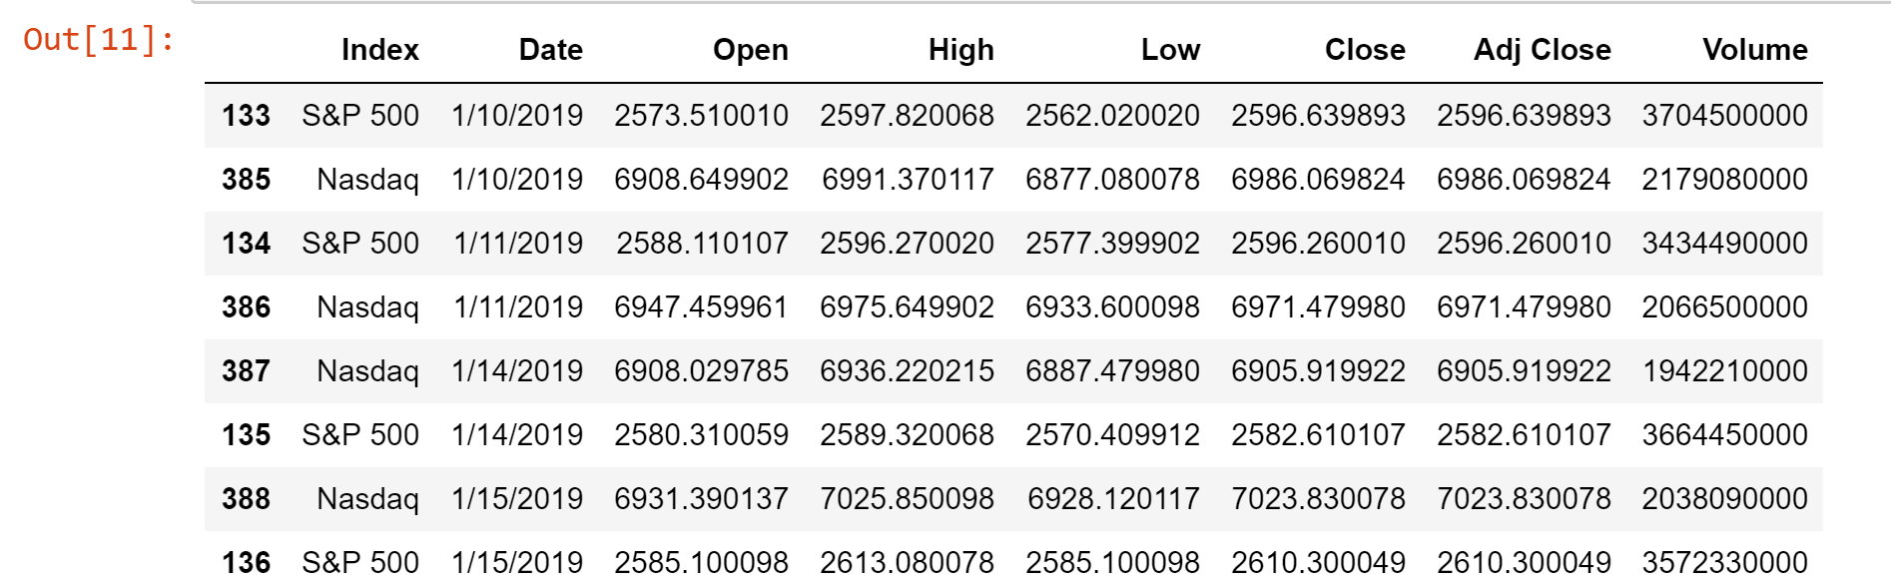
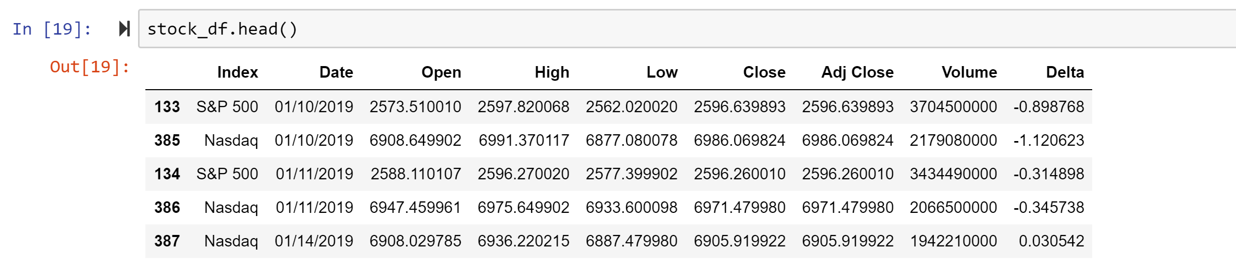
Completing the Data Set
In order to compare changes in price, we looked at the delta (Close – Open)/Open to be able to normalize data over time.

Slide 11
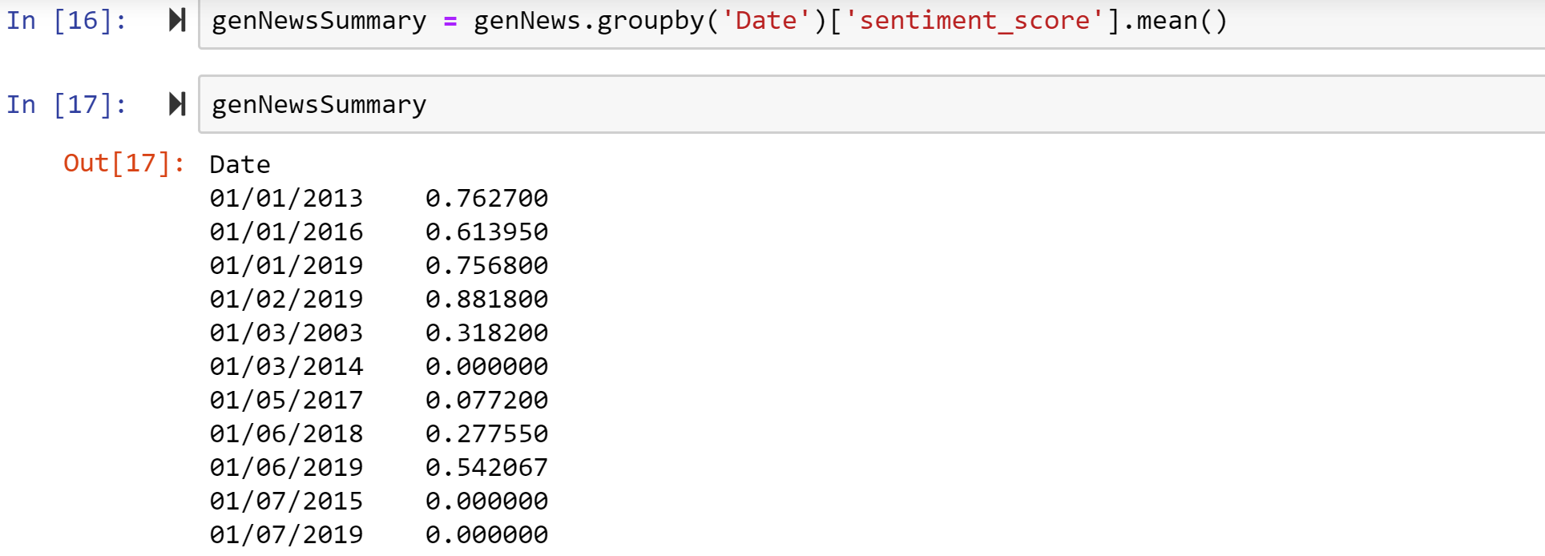
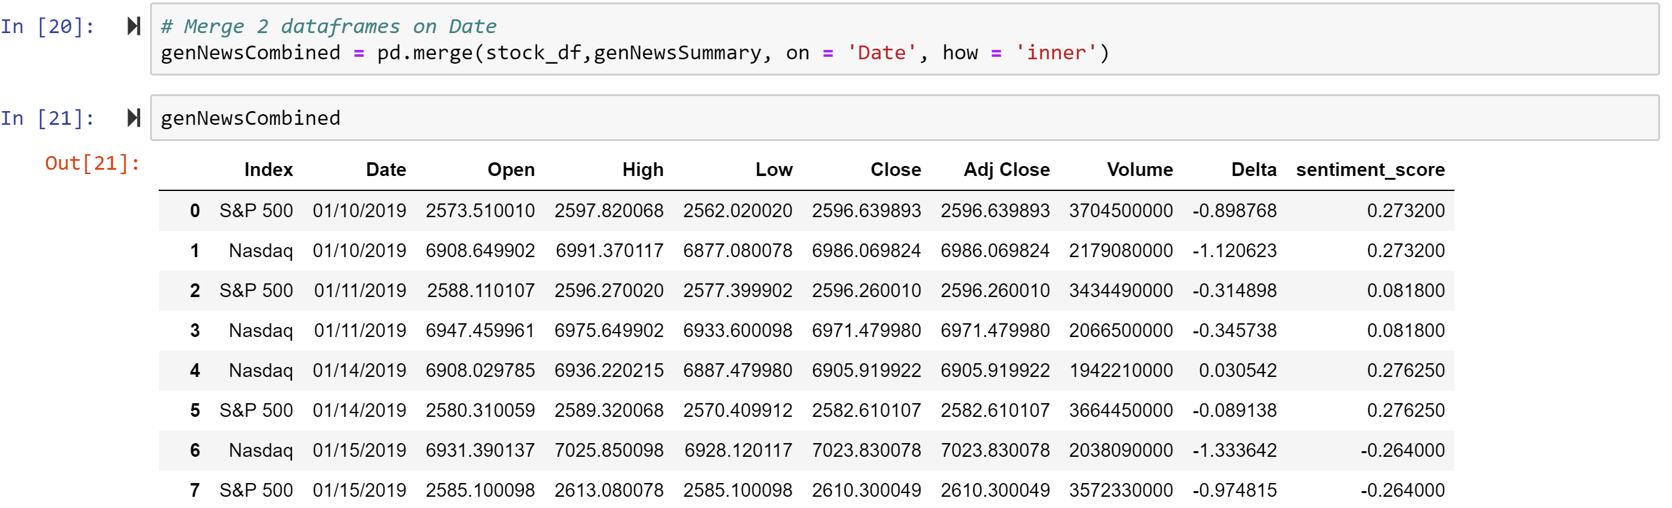
We calculated the mean sentiment score by date and merged that mean score with the financial data

Slide 12
They analysis suggests an inconsistent short run change in the value of the indexes correlating with an increase in optimistic or pessimistic local news. Neutral sentiment was infrequent and had little to no direct impact.

Slide 13
Further analysis would be necessary to identify the impact of specific types of news on related sectors of the market.

Slide 14
Are “cancelled” companies ever really cancelled?
How influential is a public scandal on a company’s stock price?

Slide 15
BAD BUSINESS PRACTICIES AND MEDIA SCRUTINY
Wells Fargo
Wells Fargo agreed to pay a $2.1 billion fine after facing allegations that it had improperly represented mortgages it sold to investors during the housing bubble. This was expected and is similar to the other banks involved in the financial crisis, but Wells Fargo was one of the last banks to deal with these issues.
Tesla
The Securities and Exchange Commission asks a federal judge to hold Musk in contempt for violating a settlement deal reached last year. Musk tweeted on February 19 that "Tesla made 0 cars in 2011, but will make around 500k in 2019." The tweets about production appear to violate the agreement reached in 2018 to have all of Musk’s company communications vetted.
Wayfair
Wayfair employees walk out of the company’s Boston-based HQs to protest Wayfair’s $200K sale of furniture to a contractor of migrant detention camps at the southern border.

Slide 16
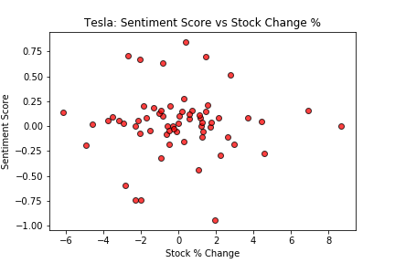
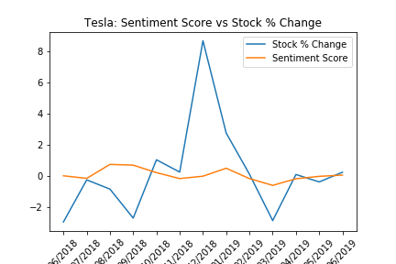
Tesla:
Sentiment Score
Vs
Stock Change %

Slide 17
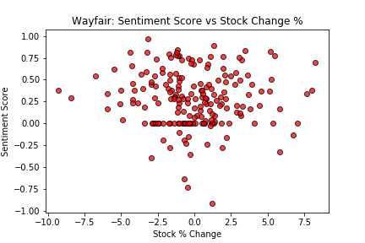
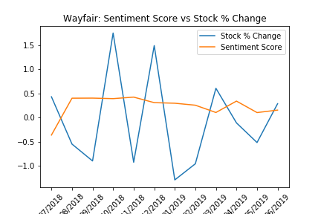
Wayfair:
Sentiment Score
Vs
Stock Change %

Slide 18
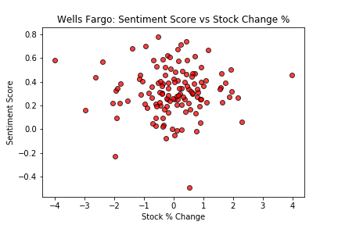
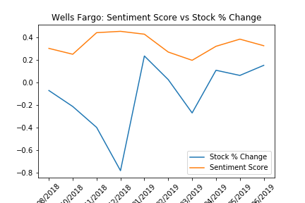
Wells Fargo:
Sentiment Score
Vs
Stock Change %

Slide 19
I will insert analysis here once I see the plots

Slide 21
This will be closing slide

Slide 22
Resources

Slide 23
Thanks! Any Questions?

